Slide 1

WELCOME BACK TO
MONEY BASICS
Facilitated by:
[Facilitator 1 name]
[Facilitator 2 name]

Slide 2
Creating a Budget; Resources to Save Money
Workshop 3
PG. 40 IN STUDENT GUIDE

Slide 3
Welcome Back!
Updates & Sharing:
How did the money saving homework go?
How did creating a list of monthly expenses go?
Today’s Agenda:
Review your PDP worksheets from last class.
Learn about the different types of expenses (fixed, variable, non-monthly, unexpected).
Follow the steps for creating a personalized, working budget:
Gather all sources of income and all monthly expenses
Separate expenses into needs vs wants
Fill out a basic budget worksheet
Identify expenses to cut back
Learn about different national, state, and local money saving resources and how to access them.

Slide 4
Community Agreements

Slide 5

Learning Objectives
Upon conclusion of Workshop 3, participants will:
Understand the definitions of fixed expenses, variable expenses, non-monthly expenses, and unexpected expenses.
Understand the differences between needs and wants and create their own working list
Create a usable budget and commit to working with it for a week
Identify areas in their budgets in which they need to adjust their spending and make a plan to do so
Have learned at least three new resources in the community for saving money

Slide 6
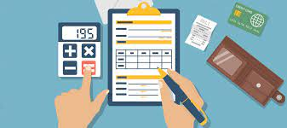
Budgeting Basics
A budget is a list of income and expenses and is a way to keep track of spending and help you save money
Important tool for financial success
The Different Types of Expenses:
Fixed Expenses
Variable Expenses
Non-monthly Expenses
Unexpected Expenses

Slide 7
Examples of non-monthly Expenses
Fixed Non-Monthly Expenses | Variable Non-Monthly Expenses
- Property taxes - AAA; Car registration renewal and tabs - Home/ renters insurance - Life insurance - Disability insurance - Car insurance - Prescription medications - Child care - Tuition costs, school fees - Bank or credit card fees | - Living space maintenance or repair - Car maintenance (new tires, oil change)/repair - Trash service - Water bill - Firewood or propane - Dental or eye care - Emergency Room visit -Books, school supplies -After-school programs, field trips -Vacation, gifts, entertainment

Slide 8

Reasons to Create a Budget:
See more clearly where your money goes
Save money towards a particular goal
Give you peace of mind about your finances
Put you in control of your finances
Reduce stress over unpaid or late bills
Pay off debts
Realize your full financial potential

Slide 9
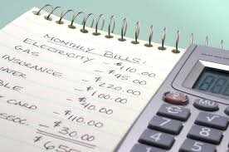
Activity
Archie is spending more than he is earning.
Help him get back on track by identifying which expenses he should cut and which he should keep.
Archie Andrews
Monthly Income: |  | Monthly Expenses:
Paycheck (after taxes) | $2100 | Rent | $800
Other Income: |  | Electric | $95
Tax return (March) | $600 | Cable (with HBO & Showtime) | $120
Christmas bonus (December) | $150 | Cell phone | $77
Birthday money (October) | $100 | Credit card (minimum) | $95
Overtime | $320 | Landline phone | $60
Total Annual Income: | $26, 370 | Car insurance | $90
Non-monthly Expenses: |  | High speed Internet | $48
Dog groomer (6 times a year) | $360 | Car loan | $190
Annual trip to the beach | $860 | Groceries | $120
Heat in winter | $420 | Pet food & supplies | $30
Total: | $1640 | Dining out: | $140
Archie has one dog and lives alone in a two-bedroom apartment. He works full time, picking up a two overtime shifts a year. He owes $3960 on his credit card and $4390 on his car loan. |  | New clothes | $60
 |  | Household goods | $60
 |  | Toiletries | $70
 |  | Starbucks | $95
 |  | Gas for car | $60
 |  | Barber | $20
 |  | Total: | $2230

Slide 10
Steps to Create a Personalized Budget
Step 1: Income
Gather every source of income you have coming in each month.
For example:
Source: | Monthly Income:
Paycheck | $ 1500
SSI/SSDI | $ 600
Yard work for neighbor | $ 100
Pet sitting | $ 50
Total: | $ 2,250

Slide 11
Steps to Create a Personalized Budget (continued)
Step 2: Regular expenses
Gather all of your regular expenses.
Step 3: Monthly expenses
Gather all of your monthly expenses.
Type: | Amount:
Monthly rent payment | $ 700
Utilities | $ 100
Car loan | $ 100
Credit card loan | $ 50
Total: | $ 950
Type: | Amount:
Groceries | $ 300
Bus fare or gas | $ 75
Prescription medicine | $ 50
Dog food and supplies | $ 20
Eating out | $ 75
Household goods | $ 100
Total | $ 620

Slide 12
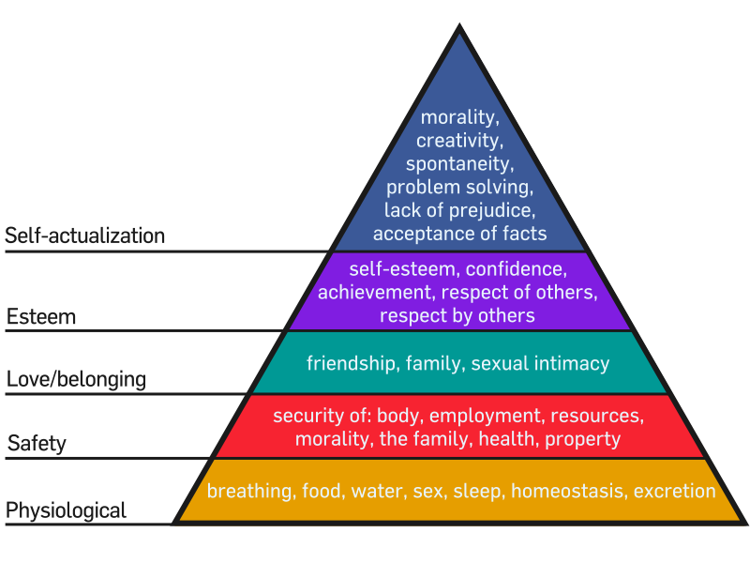
Steps to Create a Personalized Budget (continued)
Step 4: Needs vs. Wants
Separate your list of expenses into needs and wants. Identify possible areas to cut.
Step 5: Fill out your budget
Enter your income and expenses into the budgeting worksheet in your Student Guide.
See if you have any money left over after bills and other expenses are paid. If not, brainstorm areas to cut.

Slide 13
Resources for Saving Money
Federal & state resources:
SNAP
SSI/SSDI
Medicare & Medicaid
VA Benefits
Individual Development Accounts
Medication Assistance
Reduced bus fare
Reduced Internet costs
Free or reduced clinics
Local & community resources:
Mutual aid funds
Free food pantries
Farmer’s markets
Clothing swaps
Buy Nothing Project
Library books/movies
Community Credit Unions
Second-hand stores

Slide 14

Discussion
What are some additional resources you have used or know of that can help people save money?

Slide 15

Wrap-Up
Thank you all for your participation today!
Are there any questions?
Homework:
Choose one more money saving idea and commit to it for the week. Keep track of which ideas are going well and which are not.
Commit to using your personalized budget for the next week.
Find one community resource that could help save money and be prepared to share it next class.

